Slide 1



Summary (Q4)
Optical Properties of Bone Tissue Phantom
Thu Ta Zaw
2415121095

Slide 2

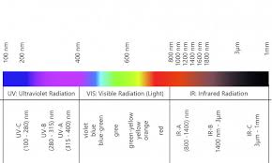
Optical Properties of Materials
Optical properties describe how a material interacts with light (electromagnetic radiation), especially UV, visible, and infrared regions.
It can determine the color, transparency and reflectivity, which are essential for cells, sensors and lenses.
When light interact with materials, it can be reflected, absorbed, transmitted, scattered and refracted.

Slide 3
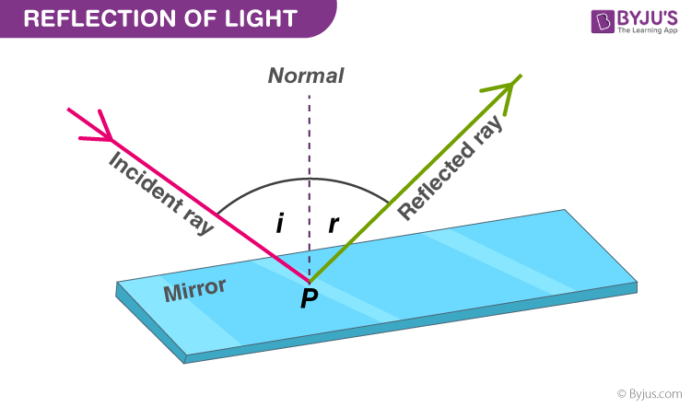
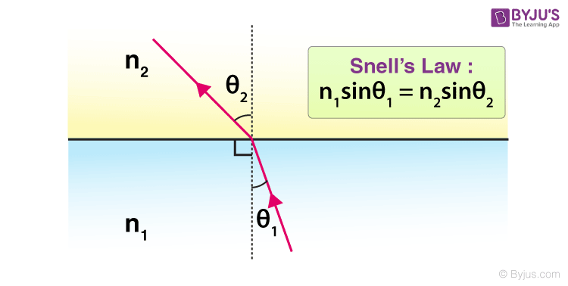
Optical Properties of Materials
Reflection
Fraction of incident light reflected from a surface.
Depends on surface roughness and refractive index.
Important for mirrors and metallic surfaces.
Refraction
Bending of light at the interface of two media.
Governed by Snell’s Law.
Important for lenses, optical fibers and skin.
Fig. Light reflection on surface
Fig. Light refracted through the medium

Slide 4
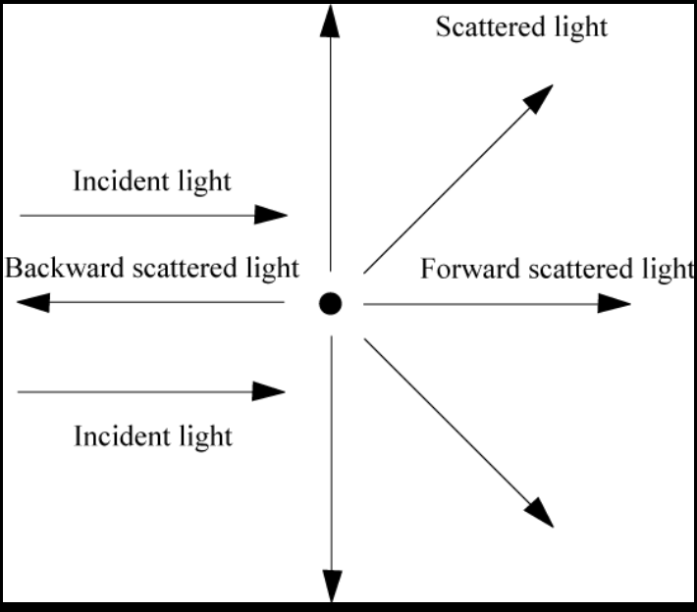
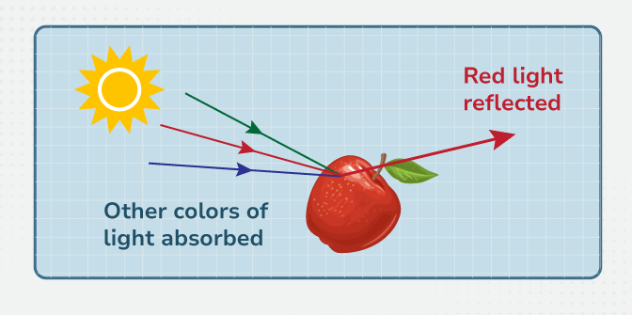
Optical Properties of Materials
Fig. Light absorption phenomenon
Fig. Light Scattering and Transmission
Light Absorption
Ability of material to absorb light energy.
Related to electronic and vibrational transitions.
Determines opacity and band gap behavior.
Light Scattering and Transmission
Scattering is the redirection of light due to particles or defects.
Transmission is the fraction of light that passes through a material.

Slide 5
Optical properties of samples (skins and phantom)
The flowing data biomedical samples can be measured using the integrating spheres:
Diffuse reflectance Rd, which is a fraction of light diffusely reflected from sample.
Total transmittance Tt, which is a fraction of light transmitted (diffuse and direct).
Specular reflectance Rs, which is a mirror-like surface reflection.
Absorptance, which is a fraction of light absorbed by sample.
The flowing optical properties can be calculated from the measured data:
Absorption coefficient μa​, which describes the photon loss due to chromophore absorption.
Reduced scattering μs′​, which describes diffusion strength of scattered light.
Anisotropy Factor g, which describes the directionality of scattering (0 = isotropic and 1 = forward).
Refractive index n, which describes the boundary reflection and transmission.
Albedo a′, which describes the ratio of scattering to total extinction.
Penetration depth δ, which describes the effective photon travel depth.

Slide 6
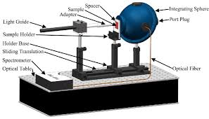
Integrating Sphere
Integrating sphere is an optical measurement tool used to quantify how light interacts with scattering and absorbing media.
It is a hollow spherical cavity, coated internally with a diffuse reflective material.
The radiation introduced into an integrating sphere strikes the reflective walls and undergoes multiple diffuse reflections.
After numerous reflections, the radiation is dispersed highly at the sphere walls.
The resulting integrated radiation level is directly proportional to the initial level and may be easily measured by using a detector.
Fig. Integrating sphere setup to measure the optical properties of sample

Slide 7
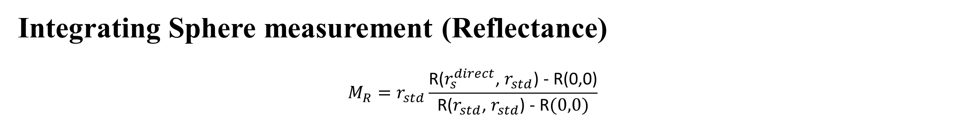
Integrating Sphere measurement (Reflectance)
$${M_{R}=r}_{std}\frac{\text{R}\text{(}r_{s}^{direct}\text{, }r_{std}\text{)}\text{ − }\text{R}\text{(0,0)}}{\text{R}\text{(}r_{std}\text{, }r_{std}\text{)}\text{ − }\text{R}(0,0)}$$
Fig. Configurations necessary to make the measurements required for the calculation of $M_{R}$
Notes:
$$r_{std}$$

Slide 8
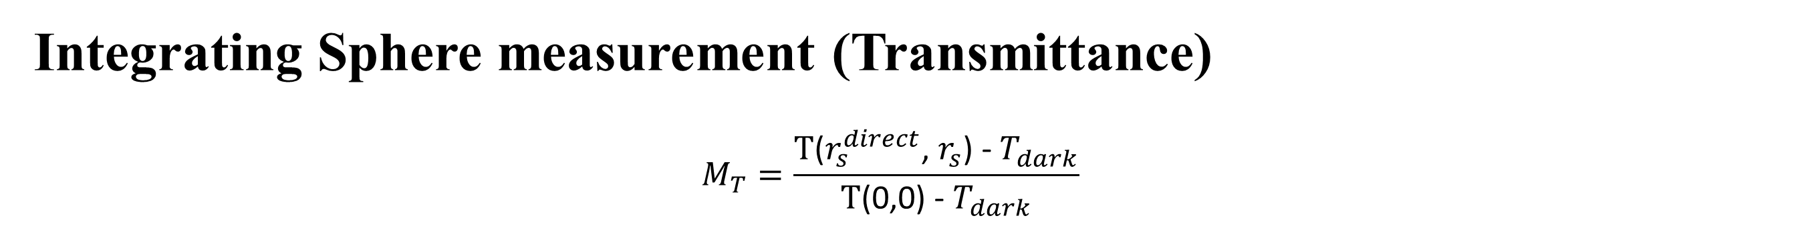
Integrating Sphere measurement (Transmittance)
$$M_{T}=\frac{\text{T}\text{(}r_{s}^{direct}\text{, }r_{s}\text{)}\text{ −}{ T}_{dark}}{\text{T}\text{(0}\text{,}\text{0}\text{)}\text{ −} T_{dark}}$$
Fig. Configurations necessary to make the measurements required for the calculation of $M_{T}$
Notes:
$$r_{std}$$

Slide 9
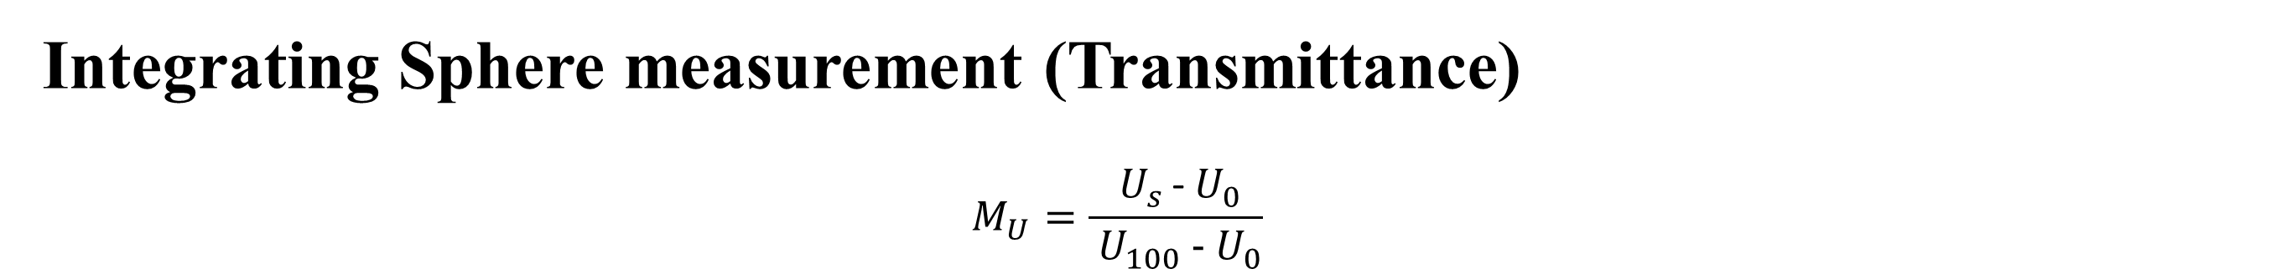
Integrating Sphere measurement (Transmittance)
$$M_{U}=\frac{{ U}_{s }\text{−}{ U}_{0}}{{ U}_{100}\text{ −}{ U}_{0}}$$
Fig. Configurations necessary to make the measurements required for the calculation of $M_{U}$
Notes:
$$r_{std}$$

Slide 10
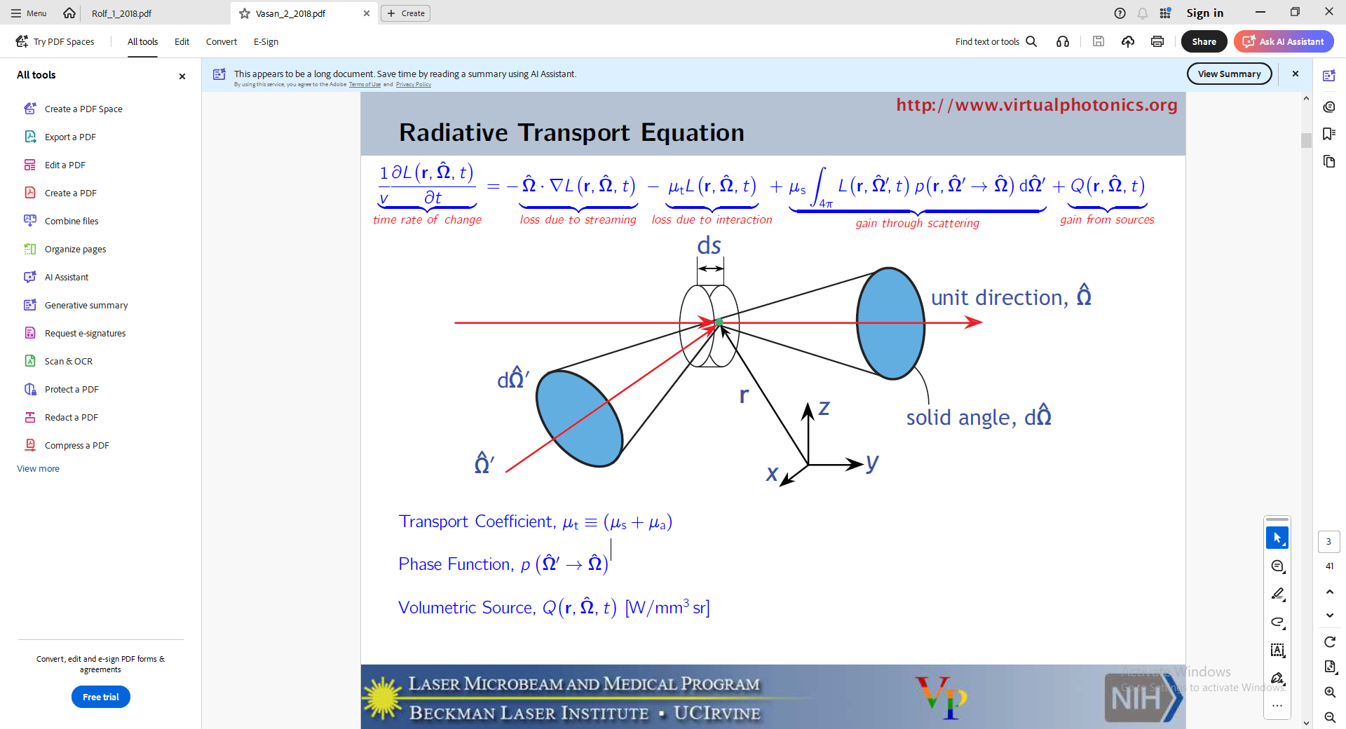

Radiative Transport equation
General Form
$$\frac{1}{v}\frac{∂\text{L}\text{(}\text{r}\text{,}\hat{\text{Ω}}\text{,}\text{t}\text{) }}{∂t}=−\hat{\text{Ω}}.∇\text{L}\text{(}\text{r}\text{,}\hat{\text{Ω}}\text{,}\text{t}\text{)}−μ_{t}\text{L}\text{(}\text{r}\text{,}\hat{\text{Ω}}\text{,}\text{t}\text{)}+μ_{s}\int_{4π}{\text{L}\text{(}\text{r}\text{,}\hat{\text{Ω}}\text{,}\text{t}\text{)}\text{p}\text{(}\text{r}\text{,}{\hat{\text{Ω}}}^{′}→ \hat{\text{Ω}}\text{)}d{\hat{\text{Ω}}}^{′}+\text{Q}\text{(}\text{r}\text{,}\hat{\text{Ω}}\text{,}\text{t}\text{)}}$$
$\text{L}\text{(}\text{z}\text{,}\text{μ}\text{)}\text{ =}$ radiance
${ \text{μ}}_{a }$= absorption coefficient
${ \text{μ}}_{s }$= scattering coefficient
$\text{p}\text{(}\text{μ}\text{,}\text{μ}\text{′)}$ = phase function (Henyey-Greenstein)
g = anisotropy (average cosine of scattering angle)
Fig. Light propagation through the space
Notes:
Time rate of change
Loss due to streaming
Loss due to interaction
Gain through scattering
Gain from sources

Slide 11
Inverse Adding Doubling Method
IAD Simulation
Inverse Adding-Doubling (IAD) is a numerical method used to determine the intrinsic optical properties of turbid media such as:
Absorption coefficient (μₐ)
Scattering coefficient (μₛ)
Anisotropy factor (g)
From experimental measurements (integrating sphere), the following values are obtained:
Total diffuse reflectance (Rₜ)
Total diffuse transmittance (Tₜ)
Un-scattered / collimated transmittance (Tc)

Slide 12
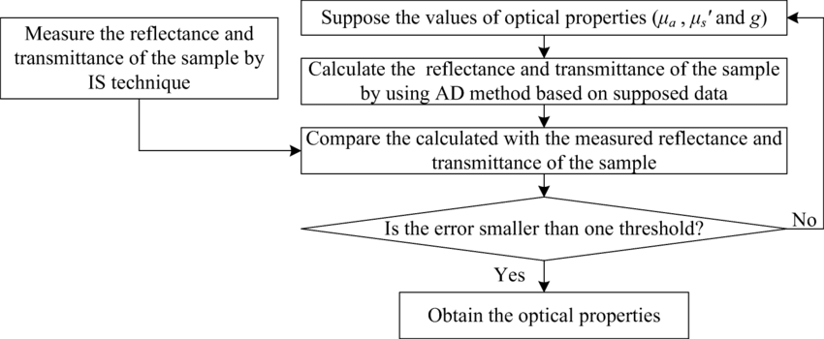
Inverse Adding Doubling Method
Working Principle
IAD works by repeatedly simulating light propagation and adjusting optical parameters until simulation matches measurement.
IAD uses an iterative, trial-an-error approach to solve the radiative transport equation.
The optical properties calculated from the algorithm are compared with measured value until they are in agree.
Fig. Process Diagram of IAD

Slide 13
Upcoming Plan
Set up Optical Sphere Experiment
Calibrate the measurement system with standard white
Create the Skin Phantom samples
Perform the measurement
Calculate the Optical properties of the skin phantom with IAD simulation
Calculate the Optical properties of the skin phantom with Monte Carlo simulation
Compare the two simulations result for the validation

Slide 14
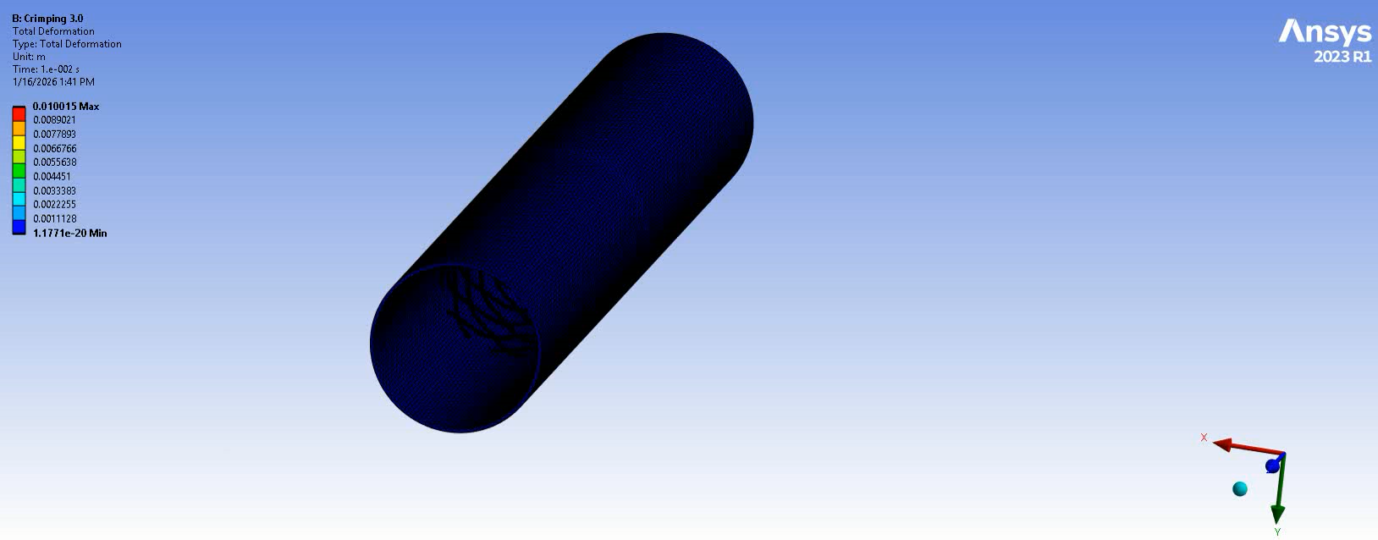
Progress of Simulation
Vid. Crimping of stent to deployment diameter

Slide 15
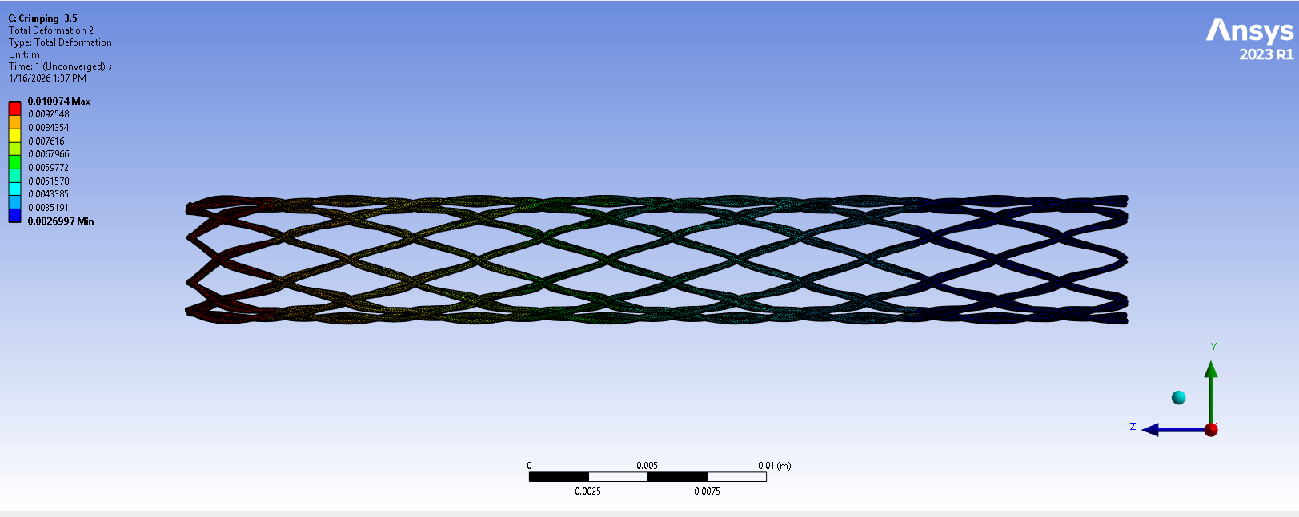
Progress of Simulation
Error in simulations
Poor-quality or distorted elements are not detected.
Asymmetric contact pairs make load transfer and stiffness become inconsistent, causing convergence instability.
Functional failure in contact pairs due to initial gaps between strut wires.
There exit a severe modelling error, with over-complex contact definition, poor contact geometry preparation and unsafe default contact parameters.
Fig. Non-convergence solution of the stent

Slide 16
The End
THANK YOU FOR LISTENING
Thu Ta Zaw
2415121095

